Slide 1

Potential Clearwater Diversion to Supplement the Palouse Basin
PBAC Research & Technical Colloquium
March 11, 2026

Slide 2
Alternate Water Supply Project Summary:
Potential Clearwater River Diversion
The Palouse Basin aquifer will remain a primary water source, but a surface water supplement is needed for long-term sustainability, due to long-observed trend of declining groundwater levels in the Palouse.
After evaluating many alternatives, a diversion from the Clearwater River near its confluence with the Snake River appears most feasible.
Current study is evaluating feasibility of diversion, conveyance, and treatment of Clearwater River water for use in the Palouse Basin.
Supplemental water could be applied to direct consumption, aquifer recharge, or a mix of both.
Preliminary study results are expected later in 2026.

Slide 3
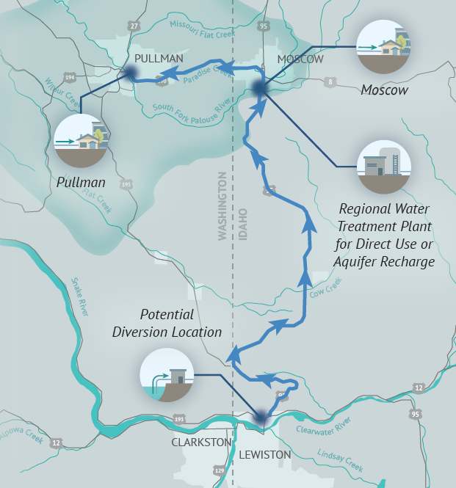
Project Concept
Diversion near Lewiston
Approximately 40 miles of piping
Multiple storage tanks likely needed
Elevation range 740 to 2960 with most of the gain occurring in the first 8 miles of the alignment
Envisioned route likely follows SH-95
Treatment likely near Moscow
Multiple end uses to be considered
Previous analyses suggested ~10 cfs of supplemental supply to stabilize aquifer levels over long-range time horizon

Slide 4
Primary Elements of Feasibility Study
Water supply assessment
Infrastructure alternatives assessment
Permitting needs identification
Stakeholder engagement

Slide 5
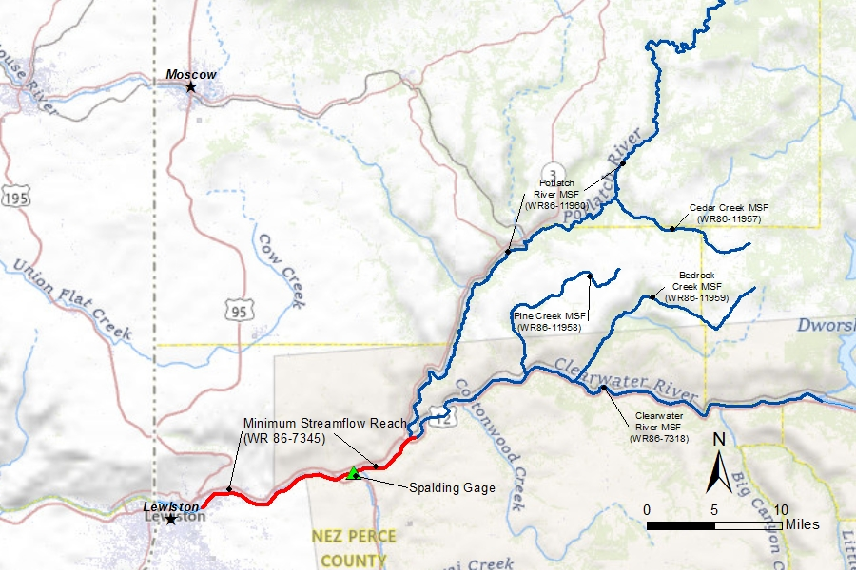
Water Supply Assessment
Analyze streamflow records
Identify long- and short-term trends
Evaluate minimum streamflow water requirements
Assess water rights considerations
Discuss with Idaho Water Resource Board the feasibility of out-of-basin use

Slide 6
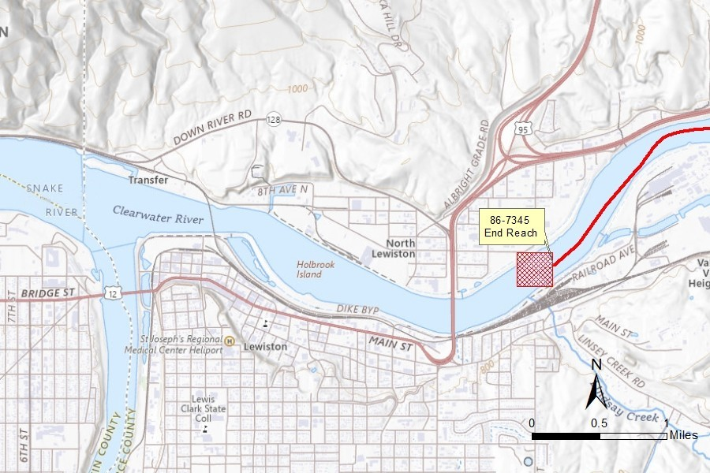
Water Rights Considerations
Most suitable diversion location may be within a minimum streamflow reach
  Nov-July: 5,910 cfs
  Aug-Oct: 4,498 cfs
Evaluating potential seasonal constraints on new diversions within this reach; and use out-of-basin

Slide 7
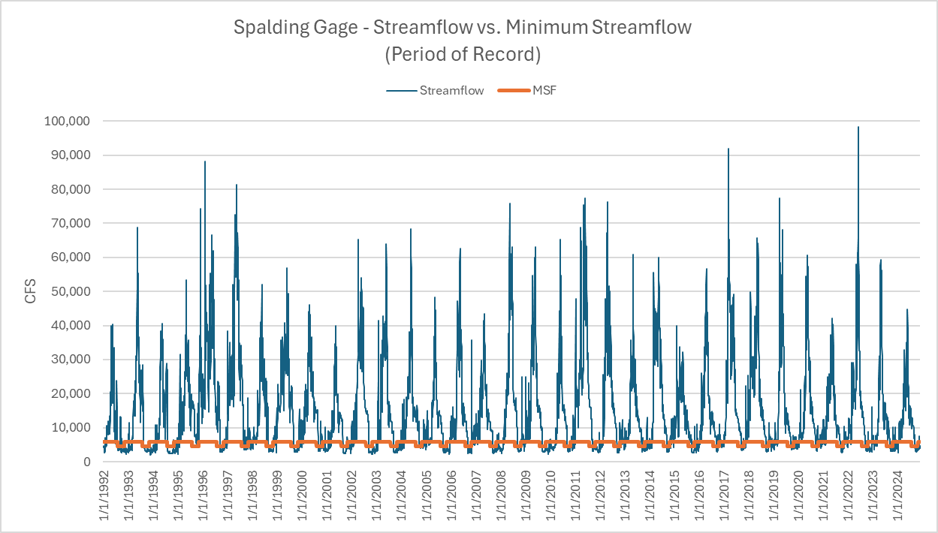
Notes:
City of Moscow seeking 10 cfs, 7,240 acre-feet per year (24/7); Flow rates spike over 40 to 50,000 cfs almost every year

Slide 8
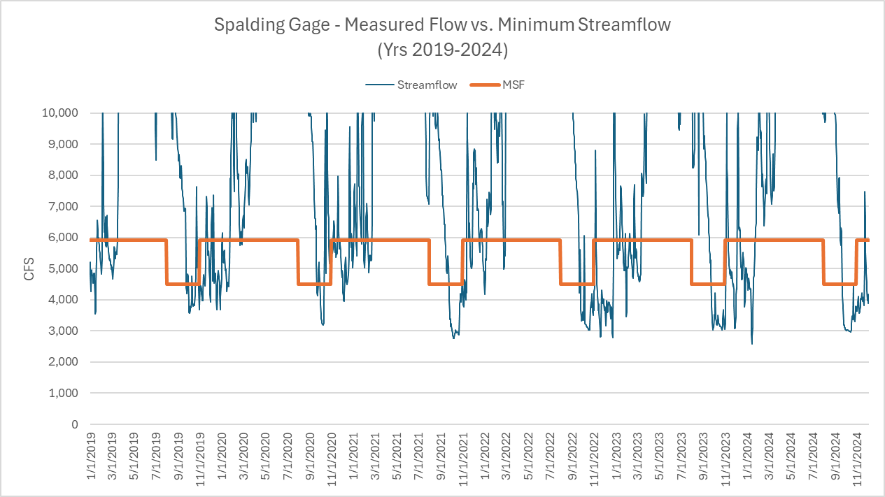
Notes:
Minimum stream flow targets not met in fall and winter months. Minimum flows generally above 3,000 cfs.
11/1 to 07/31 | 5,910 cfs.
08/1 to 10/31 | 4,498 cfs.

Slide 9
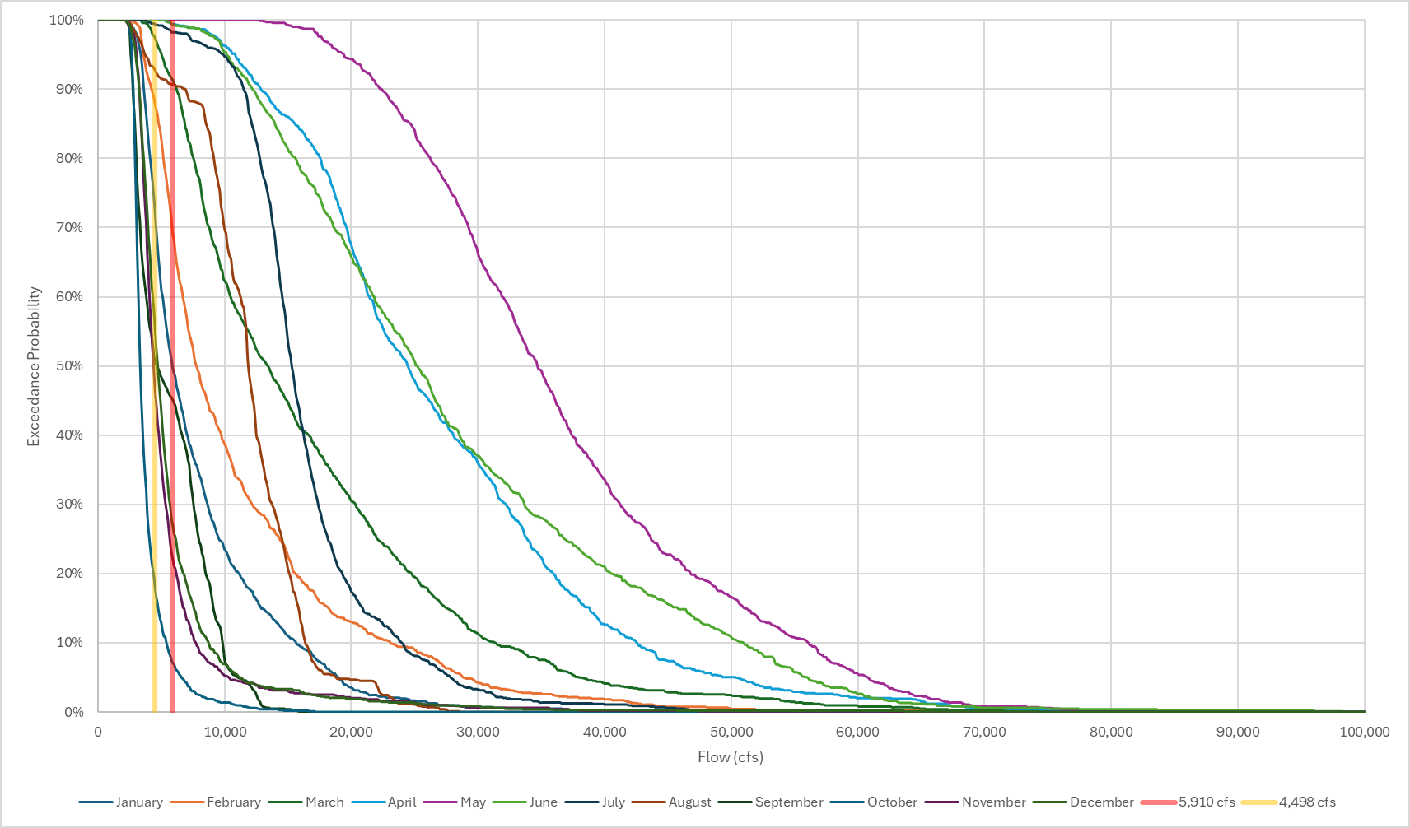
Exceedance Curves
May
E.g., 90th percentile flows exceed minimum streamflow March - August
April / June
July
August
March

Slide 10
Supply vs Demand Considerations
Desired diversion rate being evaluated
Previously-defined annual average target diversion of ~10 cfs would equate to ~20 cfs if limited to 6 months of diversion
Translates to ~13 mgd (during diversion times); total annual supply ~2.37 billion gallons (BG)
By comparison, 2024 groundwater pumping by Moscow, Pullman, universities = ~2.34 BG (PBAC 2024 Annual Report)

Slide 11
Conceptual Design Development
Currently identifying
  Potential diversion locations
  Potential conveyance routes
Next
  Treatment needs
  End uses

Slide 12
Draft Alternatives Evaluation Criteria
Criterion | Sub‑Criterion | Weight %
Cost & Schedule | Capital Cost (Class 5 OPCC) | 15
Cost & Schedule | Lifecycle / O&M Cost | 10
Cost & Schedule | Schedule Risk | 3
Permitting & Environmental | Environmental Impact | 6
Permitting & Environmental | Permitting Complexity & Risk | 7
ROW & Stakeholders | Easement Acquisition | 7
ROW & Stakeholders | Stakeholder Impacts/Support | 7
Technical & Engineering | Constructability | 8
Technical & Engineering | Geotechnical & Corrosion | 7
Technical & Engineering | Hydraulic Performance | 6
Technical & Engineering | Surge/Transient Exposure | 4
Operations, Safety & Reliability | O&M Accessibility | 7
Operations, Safety & Reliability | Emergency Response & Isolation | 5
Future Readiness & Integration | System Integration & Flexibility | 5
Future Readiness & Integration | Schedule & Overall Risk | 3
 | Total Weight | 100
Considering range of factors
Informed by input from stakeholder engagement activities

Slide 13
Permitting Needs Identification
STEP 1
Identification of Regulatory and Tribal Requirements
STEP 2
Reconnaissance-Level Environmental Review
STEP 3
Agency and Tribal
Coordination
Identify key regulatory triggers
Assess regulated resources
Identify responsible agency and tribal representatives
Collect and review background information
Reconnaissance-level field review
Summarize triggers, anticipated requirements, and approach/strategy
Early coordination with agencies and tribal representatives
Additional coordination throughout

Slide 14
Stakeholder Engagement:
A Collaborative Approach
PBAC is committed to working with and gathering information from regional stakeholders
  State regulatory agencies – ID Department of Water Resources, Water Resource Board, Fish and Game; WA Department of Ecology
  Nez Perce Tribe
  Community leaders, organizations, Palouse Basin residents
PBAC’s Stakeholder Engagement Group is an essential component of our collaboration

Slide 15
Engagement Fundamentals
    Understanding the historical, cultural, and political context
    Gathering feedback through personal connections, one-on-one meetings
    Working with stakeholder groups to listen, process, ask questions to improve project approaches and outcomes
    Communicating project information and updates with the public

Slide 16
Project Timeline
Task | Q4 2025 | Q1 2026 | Q2 2026 | Q3 2026
Water Supply Assessment
Conceptual Design Development
Permitting Needs Identification
Stakeholder Engagement
Results

Slide 17
Thank You!
Jeff Hansen
Jeff.Hansen@hdrinc.com

