Slide 1
2025 Pumping, Weather and Water Levels
PBAC Meeting
February 19, 2026

Slide 2
2025 Pumping

Slide 3
2025 Annual Pumping
Compared to 2024 = +3.6%

Slide 4
2025 Annual Pumping
Compared to 1992 = -13.0%

Slide 5
2025 Annual Pumping
Compared to 5 year trailing average = +3.4%

Slide 6
2025 Annual Pumping
?
2025 compared to 2024

Slide 7
Population and Pumping
Change from 1992

Slide 8
Per Capita Pumping
Change from 1992

Slide 9
2025 Monthly Pumping
53%
Percentage of Annual Total by Month

Slide 10
2025 Monthly Pumping
≈Outdoor
Non - Baseline
Baseline
≈Indoor
Baseline versus Non-Baseline Use

Slide 11
2025 Baseline Water Use
?
2025 compared to 2024

Slide 12
2025 Non-Baseline Water Use
✓
2025 compared to 2024

Slide 13
Annual Pumping Targets
1992-2025

Slide 14
2025 Annual Pumping Target
2025 Actual = 2,320 MG
2025 Target = 2,250 MG
☒

Slide 15
2026 Annual Pumping Target
2026 Annual Pumping Target = 2,286 MG
(34 Million Gallons less than 2025 Actual)

Slide 16

Pullman Irrigation Ordinance

Slide 17
2025 Pullman Daily Pumping
?
No outdoor irrigation allowed on Monday

Slide 18
2006-2025 Annual Pumping
Baseline and Non-Baseline

Slide 19
2025 Weather

Slide 20
Monthly Average Temperature 2007-2025
Departure from 1971-2000 average

Slide 21
Pan Evaporation 2024-2025
Change from 5 year trailing average

Slide 22
2025 Estimated Crop Evapotranspiration
2025 compared to 2024

Slide 23
2025 Monthly Pumping
?
2025 compared to 2024

Slide 24
2025 Monthly Precipitation
Moscow UI Plant Science Farm

Slide 25
2025 Water Year Cumulative Precipitation
Moscow Mountain SNOTEL site

Slide 26
2025 Water Year Snow Depth
Climate
Change
Climate
Change
Moscow Mountain SNOTEL site

Slide 27
2025 Calendar Year Cumulative Precipitation
Moscow UI Plant Science Farm

Slide 28
2025 Calendar Year Streamflow
Climate
Climate
Change
Change
Paradise Creek USGS Gage

Slide 29
2026 Water Year Cumulative Precipitation
Moscow Mountain SNOTEL site

Slide 30
2026 Water Year Snow Depth
Moscow Mountain SNOTEL site

Slide 31
2026 Water Year Snow Water Equivalent
Moscow Mountain SNOTEL site

Slide 32
2025 Water Levels

Slide 33
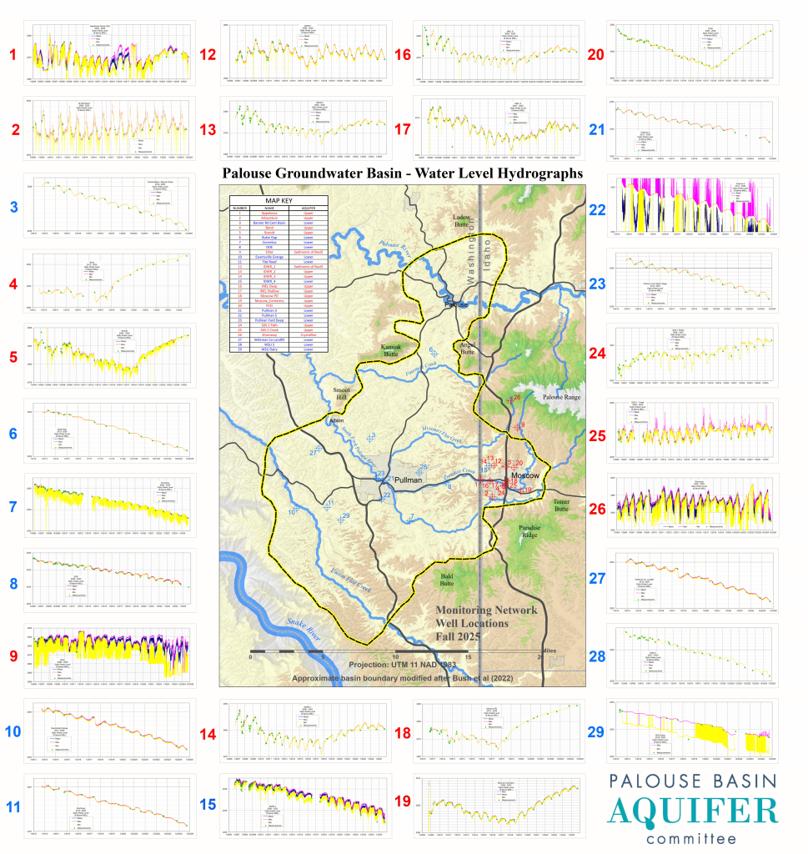
2025 Water Levels

Slide 34
2025 Water Levels – Upper Aquifer
Moscow PD Monitoring Well

Slide 35
2025 Water Levels – Upper Aquifer
Moscow Well #2

Slide 36
2025 Water Levels – Lower Aquifer

Slide 37
2025 Water Levels – Lower Aquifer
Water Level Decline Since 2013

Slide 38
2025 Water Levels – Lower Aquifer
Water Level Decline Since 2013

Slide 39
2025 Water Levels – Lower Aquifer
Average Decline = 0.72 ft/yr
Water Level Decline Since 2013

Slide 40
2025 Water Levels – Lower Aquifer
2013-2017 Decline = 0.69 ft/yr
2019-2023 Decline = 0.80 ft/yr
Water Level Decline Since 2013

Slide 41
Moscow Pumping
Upper Aquifer Average 2006-2017 = 253 MG
Lower Aquifer Average 2006-2017 = 581 MG
Upper Aquifer Average 2019-2024 = 7 MG
192 MG
Lower Aquifer Average 2019-2024 = 773 MG

Slide 42
Moscow Upper Aquifer 2004 - 2025
WL = 2498.6 ft
WL = 2499.2 ft
259 Months - 3,677 MG Pumped
Estimated Safe Yield = 170 MG/yr

Slide 43
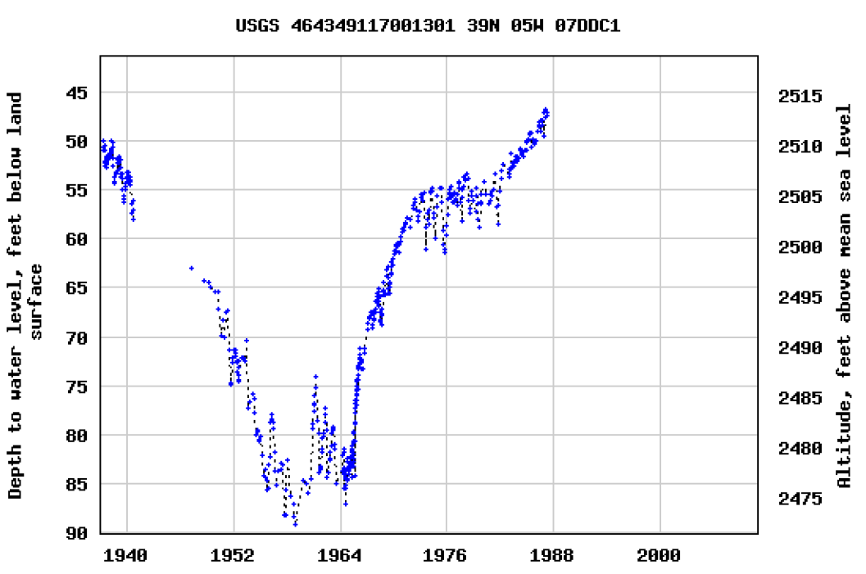
Moscow Upper Aquifer 1938 - 1988
Water Level

Slide 44
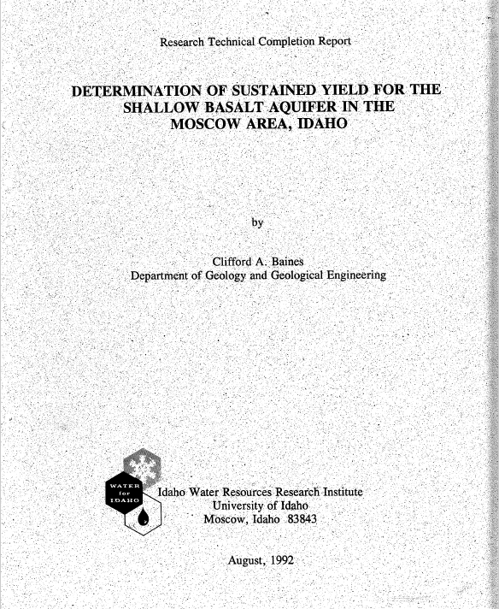
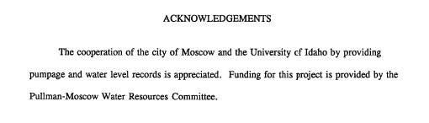
Moscow Upper Aquifer 1938 - 1988

Slide 45
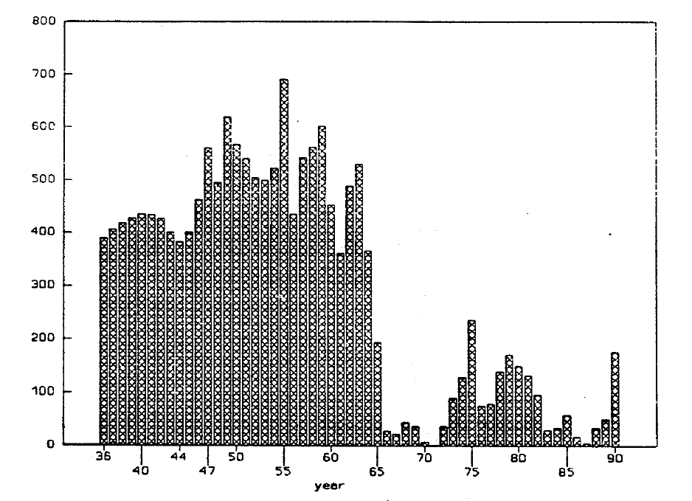
Moscow Upper Aquifer 1938 - 1988
Pumping

Slide 46
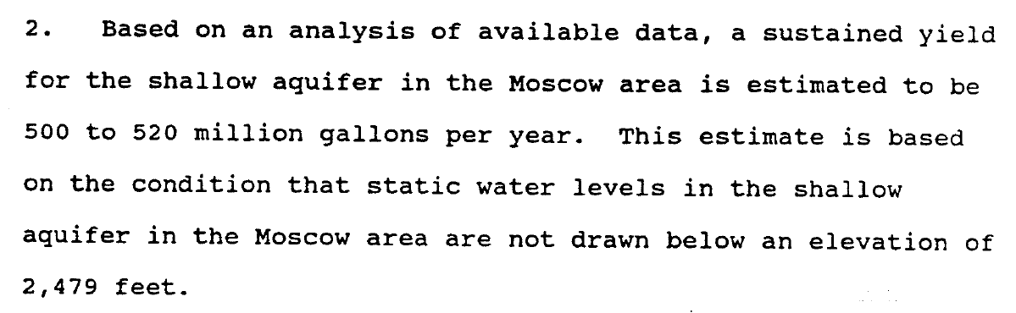
Moscow Upper Aquifer Safe Yield

Slide 47
Questions
?

Slide 48
Supplemental Slides

